Slide 1
SQL Server
Joins
In all slides, db=database

Slide 2
Normalized
A normalized database is one where the data has been broken out from larger tables into many smaller tables for the purpose of:
eliminating repeating data,
saving space,
improving performance, and
increasing data integrity

Slide 3
JOINs
When we are operating in a normalized environment, we frequently run into situations in which not all of the information that we want is in one table.
In other cases, all the information we want returned is in one table, but the information we want to place conditions on is in another table.
In these situations, this is where the JOIN clause comes in.

Slide 4
JOINs cont.
A JOIN does just what it sounds like—it puts the information from two tables together into one result set.
We can think of a result set as being a “virtual” table. It has both columns and rows, and the columns have datatypes.
JOINs match one record up with one or more other records to make a record that is a superset created by the combined columns of both records.

Slide 5
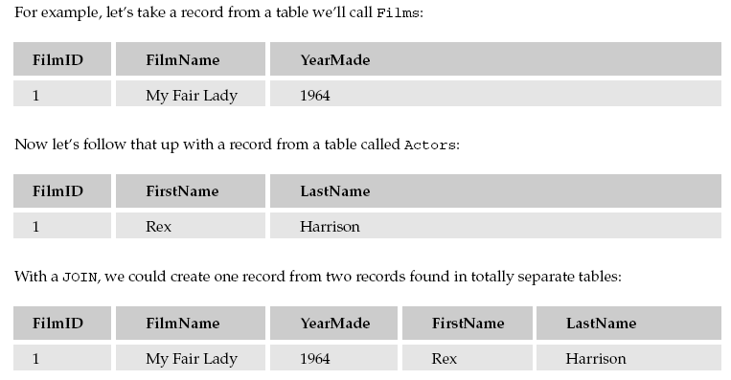

JOINs cont.
This JOIN joins records in a one-to-one relationship. We have one Films record joining to one Actors record.

Slide 6
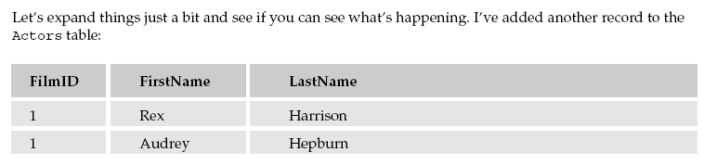
JOINs Example

Slide 7
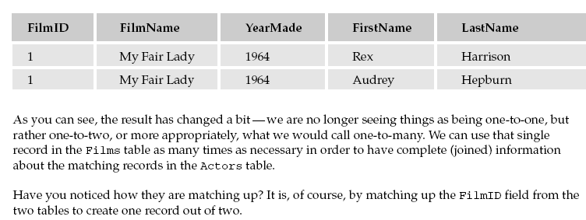
JOINs Example cont.

Slide 8
INNER JOINs
Most common type of JOIN
An INNER JOIN returns only the records where there are matches for whatever field(s) you have said are to be used for the JOIN.
An INNER JOIN is the default, and most often you will not see the word INNER in a JOIN SQL Statement.

Slide 9
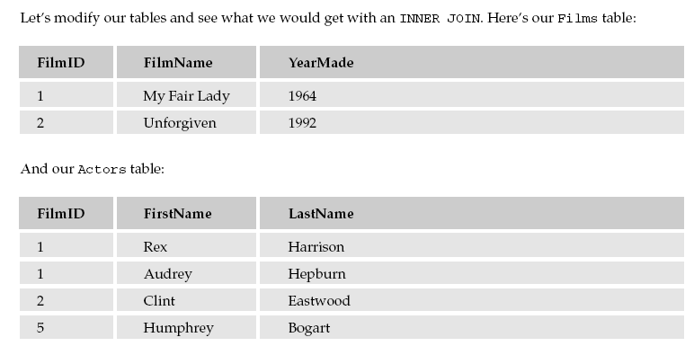
INNER JOINs Example

Slide 10
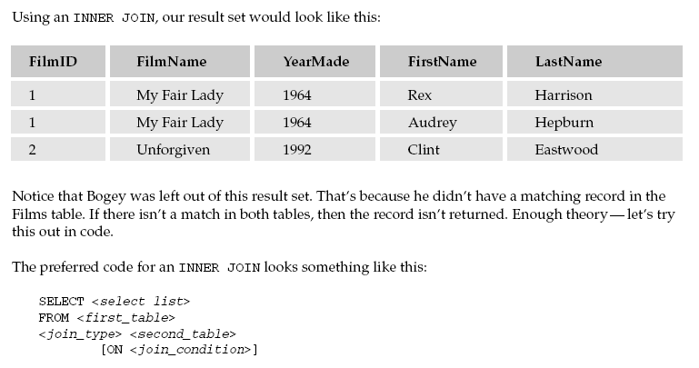
INNER JOINs Example

Slide 11
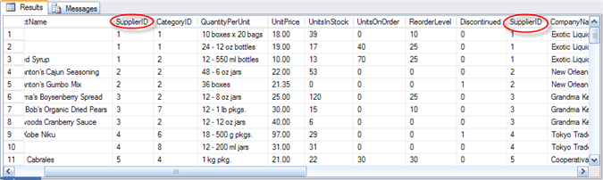
INNER JOINs Example cont.
Running an INNER JOIN on Northwind:
      77 rows returned
      SupplierID column appears twice, no indication about which table (Products or Suppliers?)
      All columns were returned from both tables
      The first columns listed were from the first table listed (Products)
SELECT * FROM Products INNER JOIN Suppliers ON Products.SupplierID = Suppliers.SupplierID

Slide 12
INNER JOINs *
We used the * operator, which as we’ve learned before is going to return all columns to us. The use of the * operator in joins is a bad habit. It’s quick and easy, but it’s also dirty—it is error-prone and can result in poor performance.
Select only the columns that you are going to be using and make your WHERE clause as restrictive as possible.

Slide 13

INNER JOINs * cont.
If you must insist on using the * operator, you should use it only for the tables from which you need all the columns. The * operator can be used on a per-table basis.
Returns an error:
While CompanyName exists only in the Suppliers table, SupplierID appears in both tables. SQL Server has no way of knowing which one we want.
SELECT Products.*, SupplierID FROM Products INNER JOIN Suppliers
ON Products.SupplierID = Suppliers.SupplierID

Slide 14
INNER JOINs * cont.
When we want to refer to a column where the column name exists more than once in our JOIN result,we must fully qualify the column name:
    Provide the name of the table that the desired column is from, followed by a period and the column name (Table.ColumnName)
    Alias the tables, and provide that alias, followed by a period and the column name(Alias.ColumnName)
SELECT P.*, S.SupplierID FROM Products P INNER JOIN Suppliers S
ON P.SupplierID = S.SupplierID

Slide 15
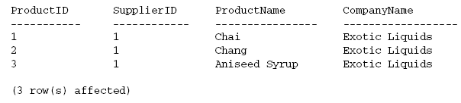
INNER JOINs cont.
SQL Server always uses a column order that is the best guess it can make at how you want the columns returned.
The nice thing is that it is easy to reorder the columns—we just have to be explicit about it. (Example is using Alias)
SELECT p.ProductID, s.SupplierID, p.ProductName, s.CompanyName FROM Products AS p INNER JOIN Suppliers AS s ON p.SupplierID = s.SupplierID WHERE p.ProductID < 4

Slide 16
INNER JOIN Like WHERE
Column ordering and aliasing are the same for any type of JOIN
So what makes an INNER JOIN unique?
  It is an exclusive JOIN – it excludes records that don’t have a value in both tables
Recall that a WHERE clause in a query also excludes rows

Slide 17
INNER JOIN Like WHERE
To illustrate, let’s take a look at another example, this time using the Customers and Orders tables
This query brings back all of the customers that have orders
The DISTINCT ensures that we only get one row for each customer
SELECT DISTINCT c.CustomerID, c.CompanyName
FROM Customers c
INNER JOIN Orders o
ON c.CustomerID = o.CustomerID

Slide 18
INNER JOIN Like WHERE
Compare rows returned to
Notice that there were two customers who did not place an order
SELECT DISTINCT c.CustomerID, c.CompanyName
FROM Customers c
INNER JOIN Orders o
ON c.CustomerID = o.CustomerID
SELECT count(*) from Customers

Slide 19
INNER JOIN Like WHERE
Why a difference between the number of rows returned by the join and the number of customers?
They were excluded from the result set because there were no corresponding records in the Orders table. This is why an INNER JOIN is comparable to a WHERE clause. Just as an INNER JOIN will exclude rows because they had no corresponding match in the other table, the WHERE clause also limits the rows returned to those that match the criteria specified.

Slide 20
OUTER JOINs
A table join in which rows from one table are included in the result set, even if they don't contain values that match those in the other table.
There are three types of outer joins: left outer, right outer, and full outer.

Slide 21
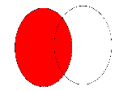
LEFT OUTER JOIN
The left outer join retrieves records from both tables, retrieving all the records from the left table and any records from the right table where the condition values match.
If there are no matching values
in from the right table, the join still retrieves all the records from the left table. Any columns from the right table that are unmatched are left NULL.
        The left circle is the left table and all the records in this circle are returned.
        The intersection represents the matching primary/foreign key values between the two tables.

Slide 22
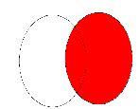
RIGHT OUTER JOIN
The right outer join is similar to the left outer join in that it retrieves all the records from one side of the relationship, but this time it's the right table.
Only records where the condition values match are retrieved from the left.

Slide 23
OUTER JOIN Example
Remember, an OUTER JOIN returns a NULL value in the columns wherever there is no match.
Note that we have 91 rows in the result set – all rows from the Customers table were returned
SELECT DISTINCT c.CustomerID, CompanyName FROM Customers AS c
LEFT OUTER JOIN Orders AS o ON c.CustomerID = o.CustomerID

Slide 24
When to use OUTER JOIN?
Use an OUTER JOIN if you are interested in bringing back all rows from a single table and want to bring in matches if they exist from an additional table

Slide 25
A Practical Use of OUTER JOIN
What customers have NOT placed an order?
What records exist in Customers that don’t have corresponding records in the Orders table?
USE Northwind
SELECT c.CustomerID, CompanyName FROM Customers AS c
LEFT OUTER JOIN Orders AS o ON c.CustomerID = o.CustomerID WHERE o.CustomerID IS NULL

Slide 26
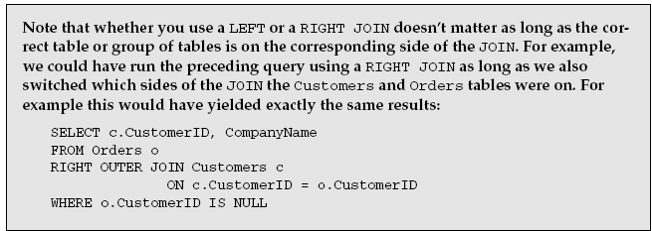
LEFT or RIGHT JOINs

Slide 27
FULL JOINs
A matching up of data on both sides of the JOIN with everything included no matter what side of the JOIN it is on.
Not used very often.
Use a FULL JOIN when you want all records from both sides of the JOIN—matched where possible, but included even if there is no match.

Slide 28
CROSS JOINs
A CROSS JOIN differs from other JOINs in that there is no ON operator, and that it joins every record on one side of the JOIN with every record on the other side of the JOIN.
Not used very often.

Slide 29
UNION
The UNION command is used to select related information from two tables, much like the JOIN command.
However, when using the UNION command all selected columns need to be of the same data type.
With UNION, only distinct values are selected.

Slide 30
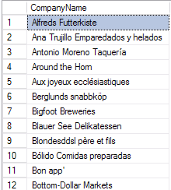
UNION cont.
USE Northwind
SELECT CompanyName FROM Customers
UNION
Select CompanyName FROM Suppliers
Assumes we want to throw out duplicate rows.

